Slide 1
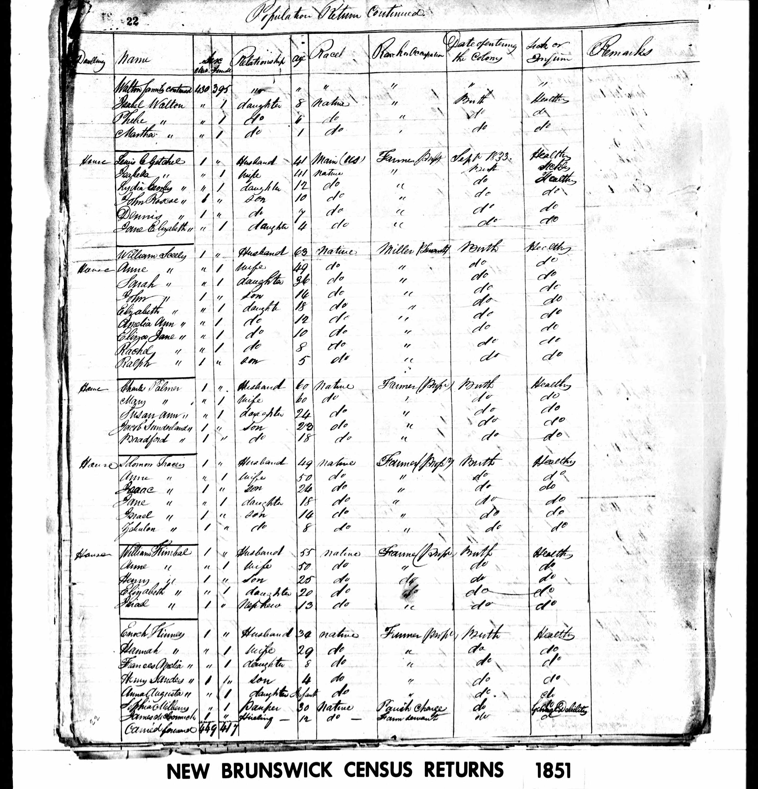

Canada Census Research
Maritime Provinces
(New Brunswick, Nova Scotia & Prince Edward Island)
Presented by David A. Walker
https://www.ancestraltrails.ca

Slide 2
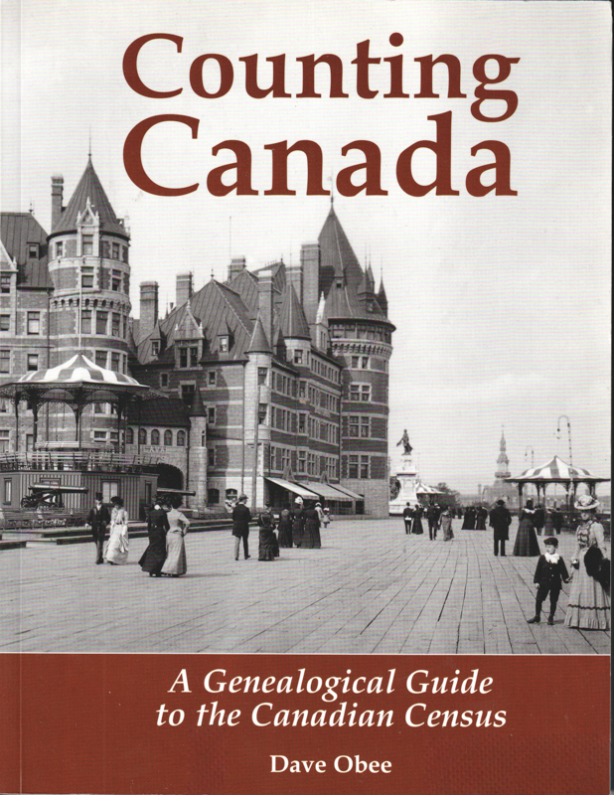
This book is highly recommended for those conducting research on Canadian census returns, available on Amazon.ca and eBay.ca.

Slide 3
Introduction – Eastern Canada
1611 Census of native population, Nova Scotia, New Brunswick & other parts

Slide 4
Introduction – Eastern Canada
1666 First Canadian census completed in New France (territory colonized by France in mainland North America). Pop. 3,215.
Another census taken the following year calculated a population of 3,918.
In 1681 there was another New France census, pop. 9,677.
These three censuses are available for viewing on microfilm from Library and Archives Canada.

Slide 5
Introduction – Eastern Canada
1671 Earliest census record of Acadians in New Brunswick

Slide 6
Introduction – Eastern Canada
1825 Lower Canada (Québec), in French, 20 June to 20 September, pop. 479,288

Slide 7
Introduction – Eastern Canada
1831 Lower Canada (Québec), 1 June to 1 October, pop. 553,134

Slide 8
Introduction – Eastern Canada
1836 Newfoundland, pop. 73,705

Slide 9
Introduction – Eastern Canada
1838 Nova Scotia. Listed the heads of households, other family members by sex and age group

Slide 10
Introduction – Eastern Canada
1842 Census Lower (Québec) Canada, proved to be a failure.
It was repeated in March, April and May, 1844, pop. 697,084

Slide 11
Introduction – Eastern Canada
1845 Newfoundland, pop. 96,295

Slide 12
Introduction – Eastern Canada
1851 Nominal census in Canada East (Québec, still known as Lower Canada), pop. 890,261, New Brunswick, pop. 193,800, and Nova Scotia, pop. 276,854. PANB published an index, county by county.

Slide 13
Introduction – Eastern Canada
1852 Nominal census in Canada East and Canada West

Slide 14
Introduction – Eastern Canada
1871 First census of the new Dominion of Canada

Slide 15
Introduction – Eastern Canada
1891 pop. 4,833,239

Slide 16
Introduction – Eastern Canada
Canada adopted the practice of the UK, having its censuses every decade plus one.

Slide 17
Introduction – Eastern Canada
1901 was the first time that a census recorded the complete birthdate of inhabitants, pop. 5,371,315

Slide 18
Introduction – Eastern Canada
1911 recorded only the month & year of birth, pop. 7,206,643

Slide 19
Introduction – Eastern Canada
1921 pop. 8,788,483, lower than expected due to fatalities of World War I

Slide 20
Introduction – Eastern Canada
1931 is currently the most recent census for public viewing, pop. 10,376,786 (mid-2026 projected to be 40,467,728)

Slide 21
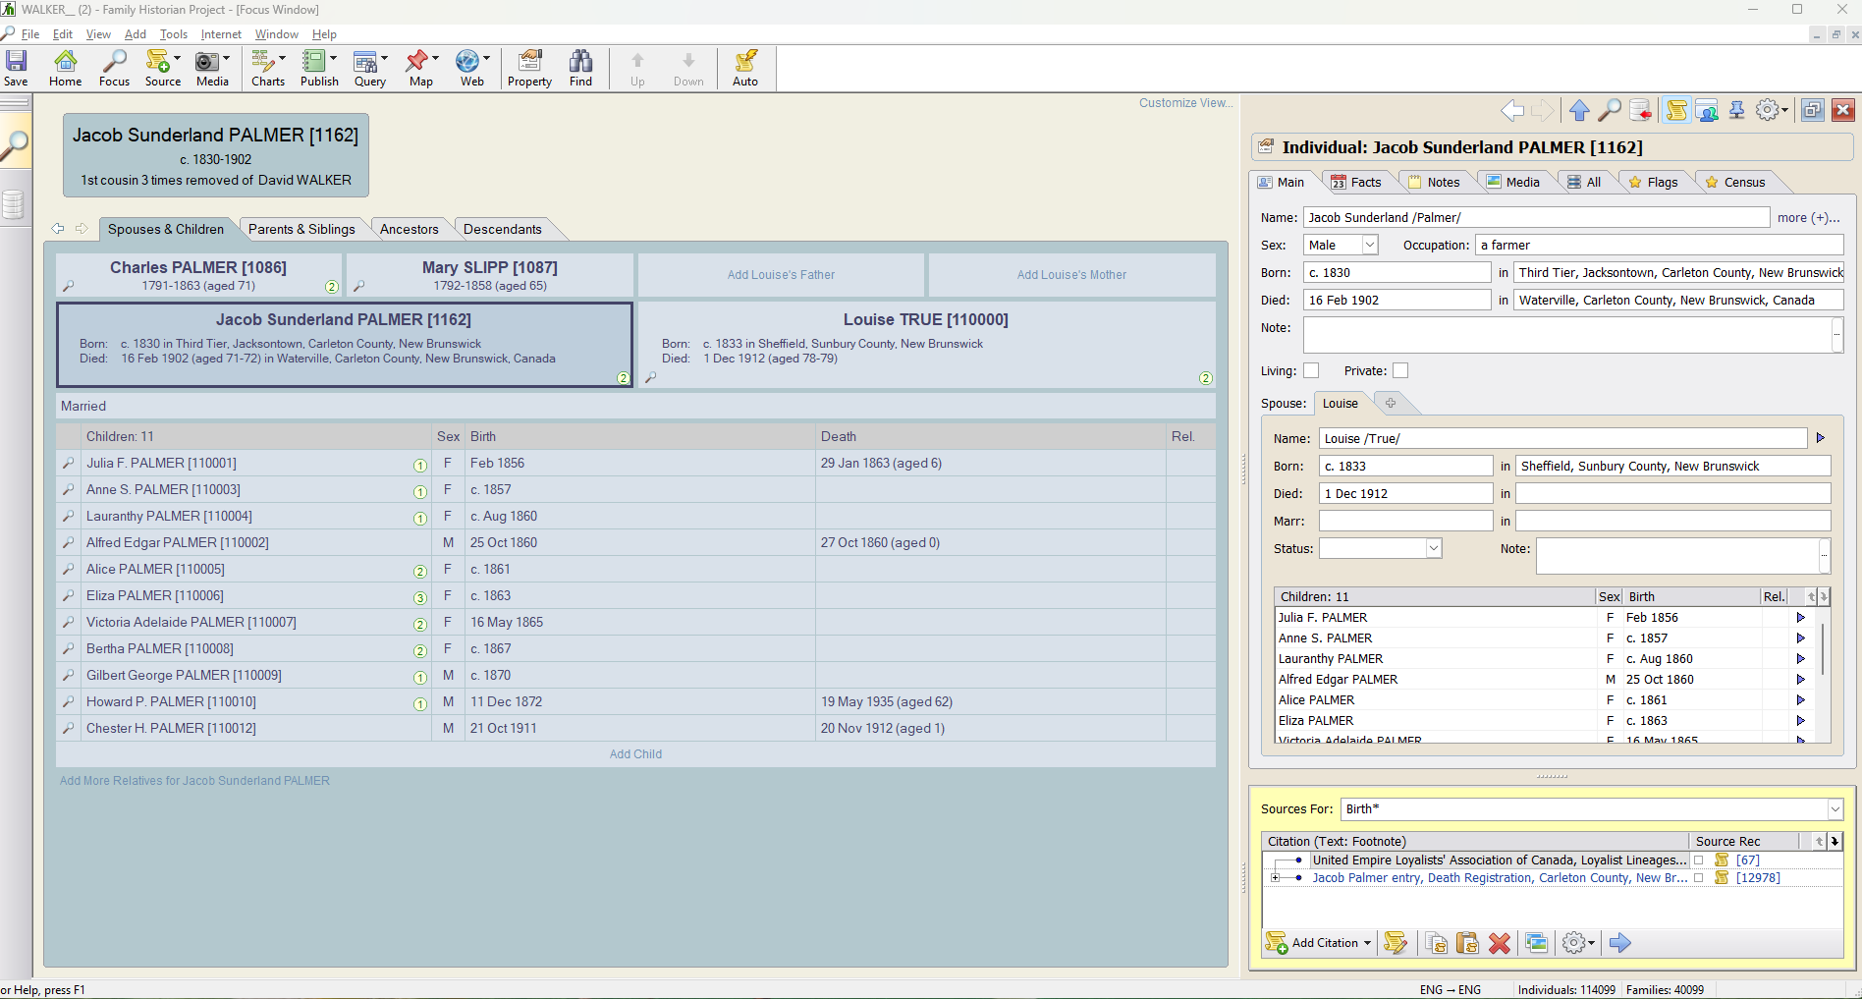
Family Historian v. 7.0.24.1
Notes:
I need to research better birth and other details for family of Jacob Palmer.

Slide 22
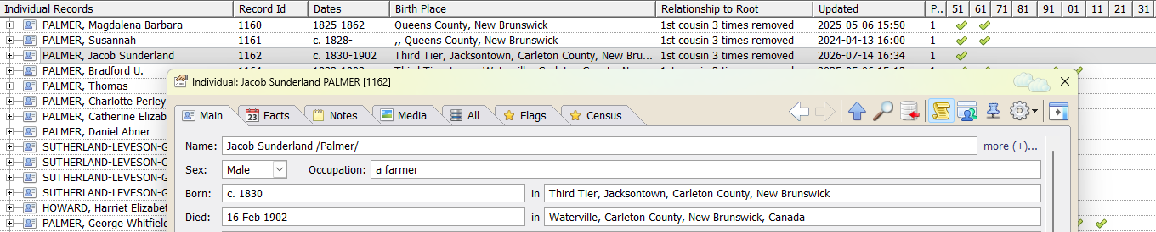
Featured person is Jacob Sunderland Palmer, a grandson of United Empire Loyalist Marcus Palmer Sr.
A custom feature of Family Historian displays columns to indicate whether a selected person has appeared in a particular census.

Slide 23
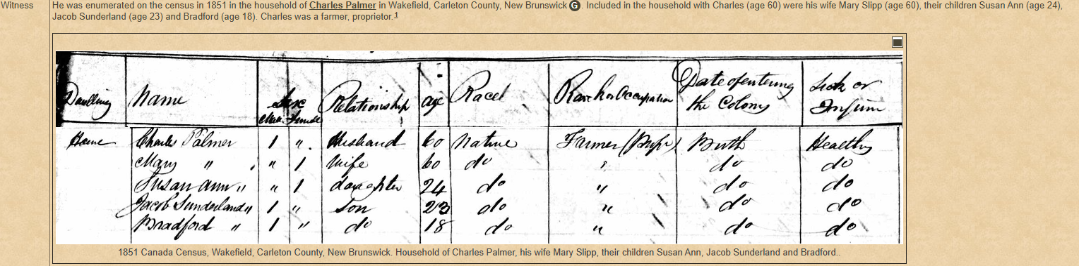
1851 Canada Census – New Brunswick
Having been made a witness in the enumeration of his father’s household, he appeared as son of Charles in my web site.
This web site was created using GedSite and Family Historian with a plugin by Mike Tate.
Columns on Schedule 1 featured Dwelling, Name, Sex, Relationship to Head, Age, Race, Rank or Occupation, Date of Entering the Colony, Sick or Infirm, Remarks.

Slide 24
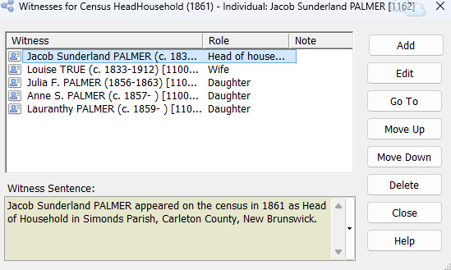
To enable Jacob’s family members to show in various censuses, they were added as witnesses to each census.

Slide 25
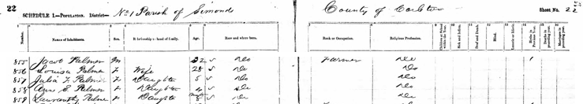
1861 Canada Census – New Brunswick
Parish of Simonds, County of Carleton
There were more detailed entries in the 1861 census.
Columns on Schedule 1 featured Dwelling, Name of Inhabitants, Sex, Relationship to Head of Family, Age, Race and Where Born, Rank or Occupation, Religious Profession, Children at School Within the Year, Sick and Infirm, Deaf & Dumb, Blind, Lunatic or Idiot, Birth in Previous Year, Death in Preceding Year, Marriages in Preceding Year.

Slide 26
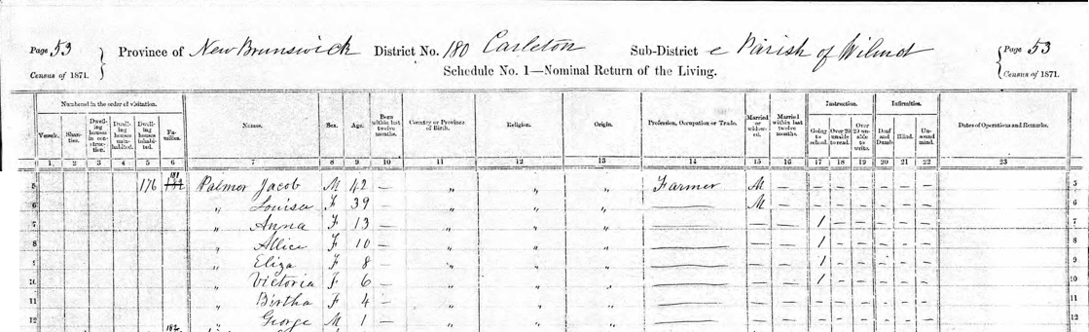
1871 Canada Census – New Brunswick
Parish of Wilmot, County of Carleton
Columns on Schedule 1 featured Numbered in Order of Visitation: Vessels, Shanties, Dwelling Houses in Construction, Dwelling Houses Uninhabited, Dwelling Houses Inhabited, Families. Names, Sex, Age, Born Within the Last Twelve Months, Country or Province of Birth, Religion, Origin, Profession, occupation or Trade, Married or Widowed, Married Within the Last Twelve Months, Instruction: Going to school, Over 20 unable to read, Over 20 unable to write. Infirmities: Deaf and Dumb, Blind, Unsound mind. Dates of operations and remarks.

Slide 27
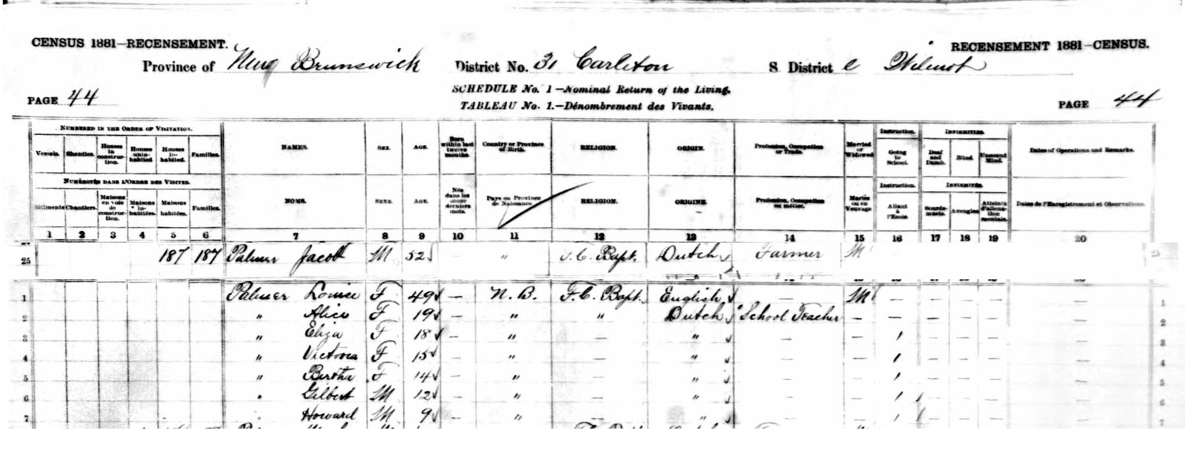
1881 Canada Census – New Brunswick
Parish of Wilmot, County of Carleton
Columns on Schedule 1 featured Numbered in Order of Visitation: Vessels, Shanties, Dwelling Houses in Construction, Dwelling Houses Uninhabited, Dwelling Houses Inhabited, Names, Sex, Age (at last birthday), Born within last twelve months, Country or province of birth, Religion, Origin, Profession, occupation or trade, Married or widowed, Instruction: Going to school, Infirmities: Deaf and dumb, Infirmities: Blind, Infirmities: Unsound mind, Dates of operations and remarks.

Slide 28
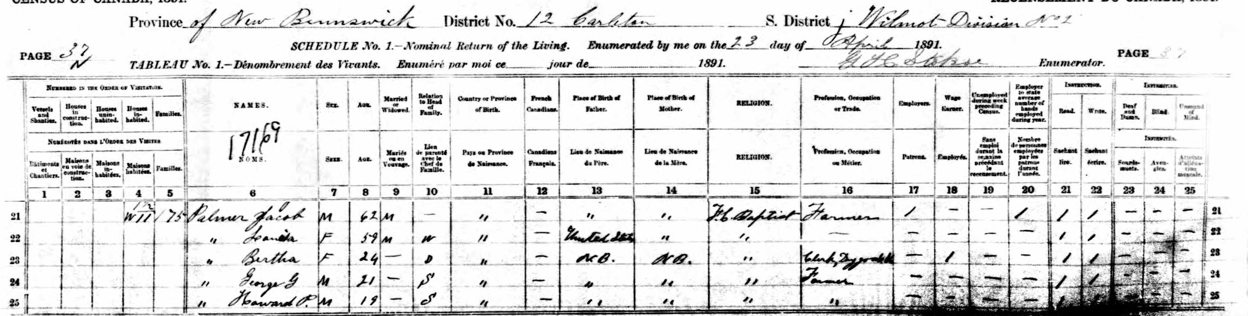
1891 Canada Census – New Brunswick
Parish of Wilmot, County of Carleton
Columns on Schedule 1 featured Numbered in Order of Visitation: Vessels, Shanties, Dwelling Houses in Construction, Dwelling Houses Uninhabited, Dwelling Houses Inhabited, Names, Sex, Age, Married or widowed, Relationship to head of family, Country or province of birth, French Canadians, Place of birth of father, Place of birth of mother, Religion, Profession, occupation or trade, Employers, Wage earner, Unemployed during the week preceding the census, Employer to state average number of hands employed during the year, Instruction: Read, Write, Deaf and Dumb, Blind, Unsound of mind.

Slide 29
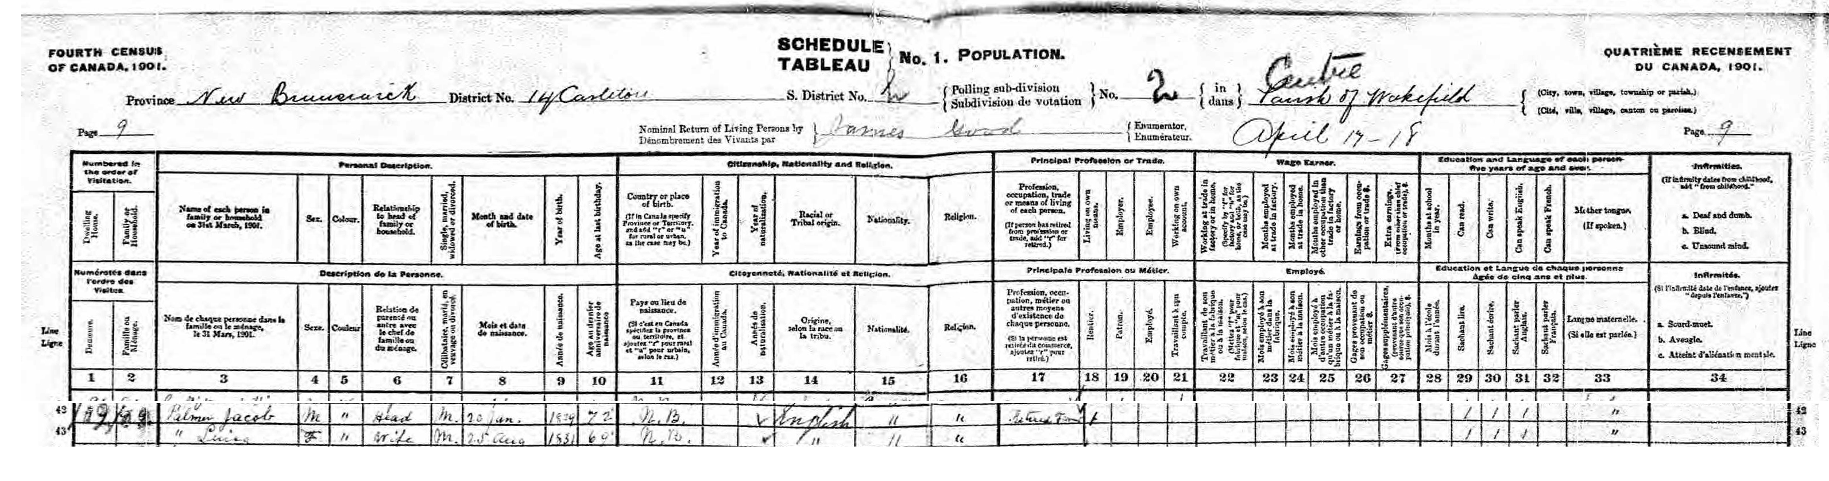
1901 Canada Census – New Brunswick
Parish (Centre) of Wakefield, County of Carleton
Columns on Schedule 1 Population featured Numbered in Order of Visitation: Dwelling House, Family or household, Personal description: Name of each person in family or household on March 31, 1901, Sex, Colour, Relationship to head of family or household, Single, married, widowed or divorced, month and date of birth, year of birth, Age at last birthday, Citizenship, nationality and religion: Country of place of birth (if in Canada specify province or territory and add “r” or “u” to signify rural or urban. Year of immigration to Canada, Year of naturalization, Racial or tribal origin, Nationality, Religion. Principal profession or trade: Means of living of each person (if person has retired from profession or trade, add “r” for retired), Living on own means. Employer. Employee. Working on own account. Wage earner: Months employed at trade in factory or home, months employed in other occupation than trade in factory or home, Earnings from occupation or trade dollars, Extra earnings. Education and language of each person five and over: Months at school in year, Can read, Can write, Can speak English, Can speak French, Mother tongue (if spoken). Infirmities: Deaf and Dumb, Blind, Unsound mind (if infirmity dates from childhood, add “from childhood”.

Slide 30
Having entered data for all census returns during Jacob’s lifetime, there are now checkmarks for all years.

Slide 31
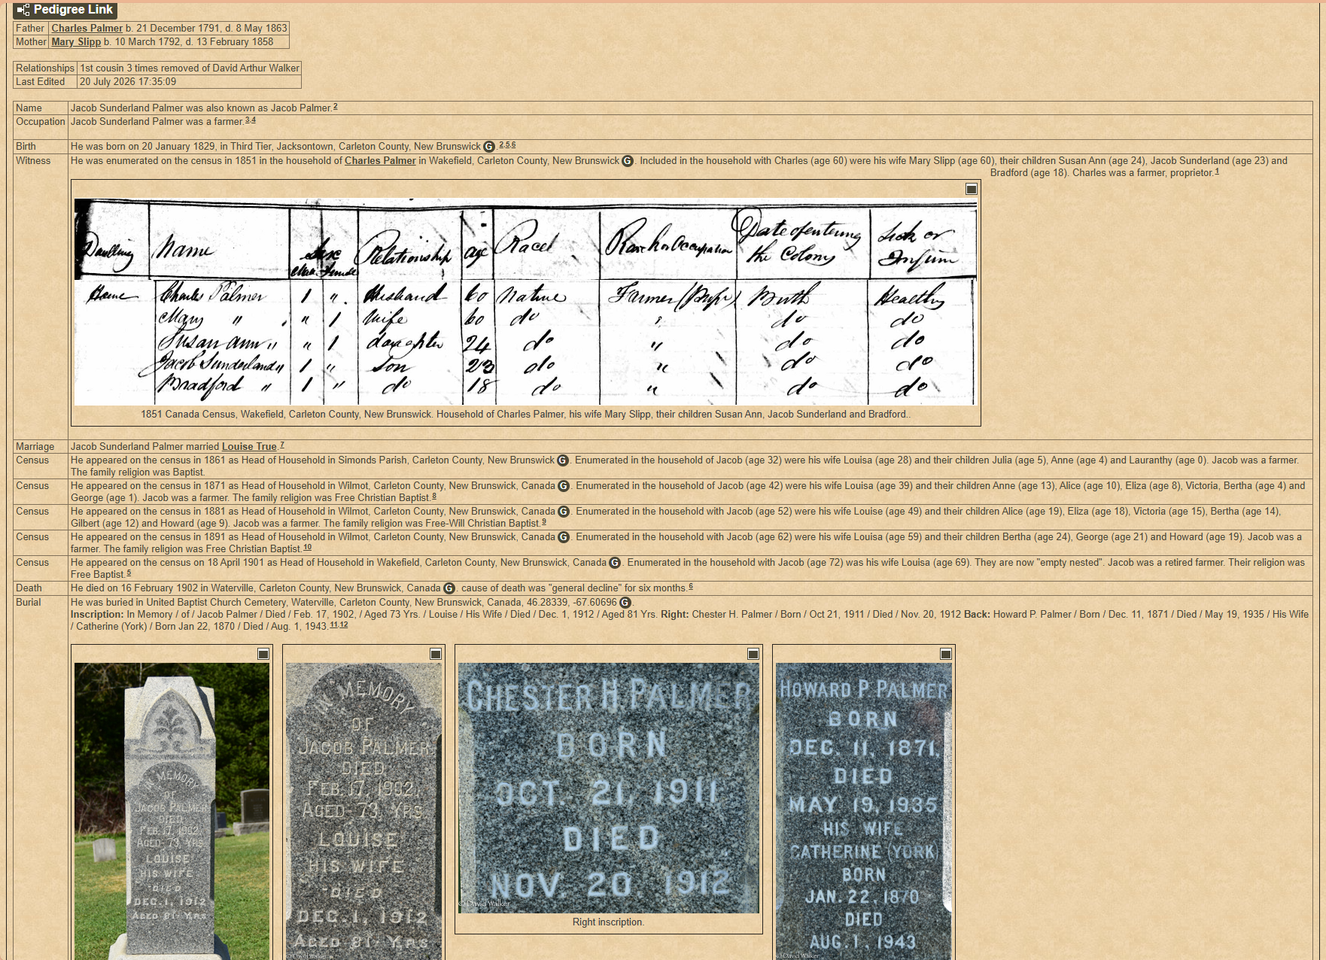

Slide 32
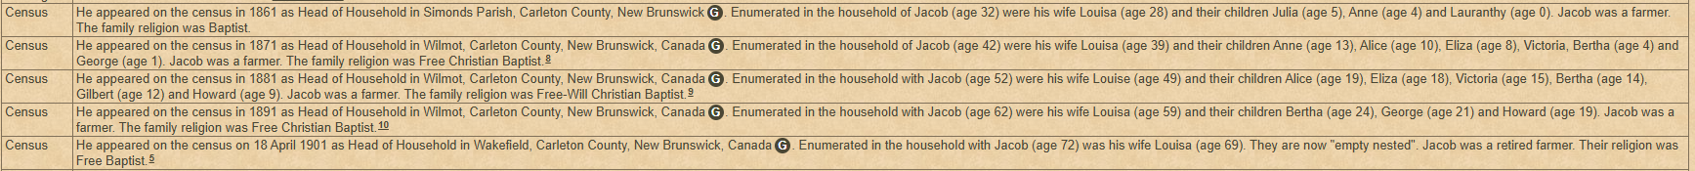
As Head of Household, Jacob appeared in the censuses of 1861, 1871, 1881, 1891 and 1901.

Slide 33
Jacob died in 1902. One of his children will be next featured for the 1911, 1921 and 1931 censuses.

Slide 34
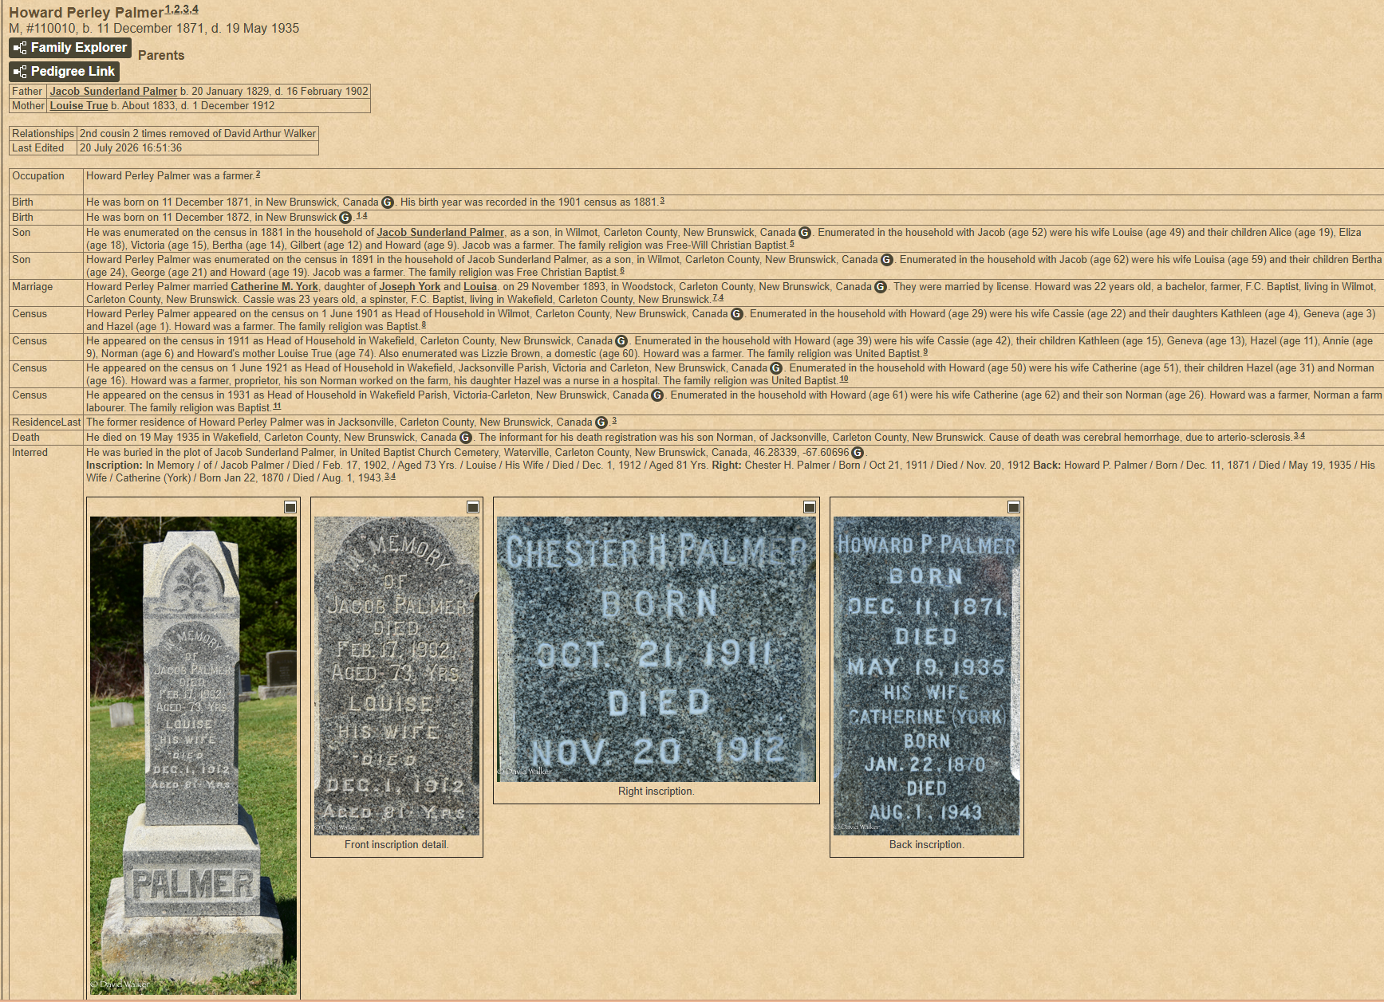

Slide 35
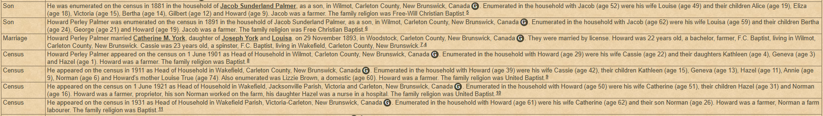

Slide 36
Howard Perley Palmer was the youngest child of Jacob Sunderland Palmer and Louise True. He will be used as an example for the 1911, 1921 and 1931 censuses. He was already enumerated in the censuses of 1881, 1891 and 1901 with his parents and siblings.

Slide 37
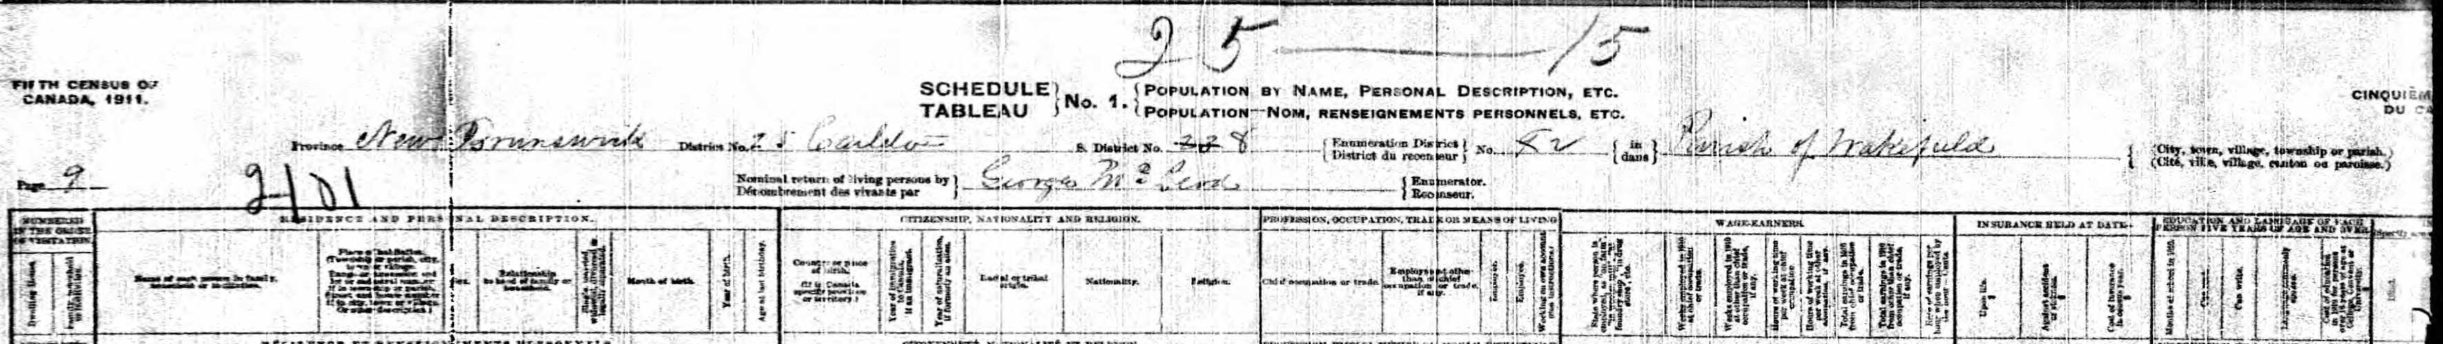
1911 Canada Census – New Brunswick
Parish of Wakefield, County of Carleton
Columns on Schedule 1 Population featured Numbered in Order of Visitation: Dwelling House, Family, household or institution.
Personal description: Name of each person, Place of habitation, Sex, Relationship to head of family, single, married, divorced or legally separated, Month of birth, Year of birth, age at last birthday.
Citizenship, nationality and religion: Country or place of birth, Year of immigration to Canada, Year of naturalization, Racial or tribal origin, Nationality, Religion.

Slide 38
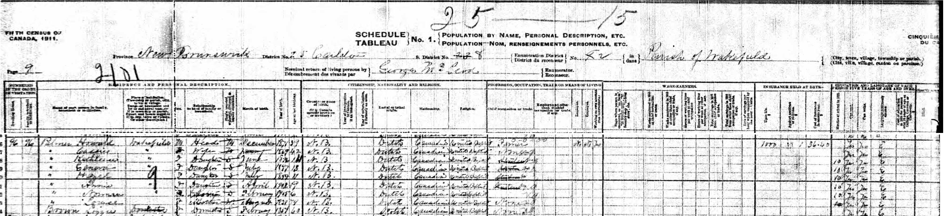
1911 Canada Census – New Brunswick
Parish of Wakefield, County of Carleton

Slide 39
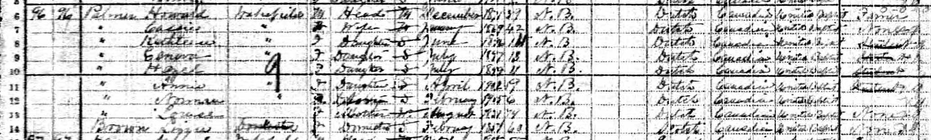
1911 Canada Census – New Brunswick
Parish of Wakefield, County of Carleton
Palmer, Howard Wakefield, Head, M, December 1871, 39, N.B., Dutch, Canadian, United Baptist, farmer
“, Cassie, “ , Wife, M, January 1869, 42, N.B., Dutch, Canadian, United Baptist, none
“, Kathleen, “ , Daughter, S, June 1896, 15, N.B., Dutch, Canadian, United Baptist, Student
“, Geneva, “ , Daughter, S, July 1897, 13, N.B., Dutch, Canadian, United Baptist, Student
“, Hazel, “ , Daughter, S, July 1899, 11, N.B., Dutch, Canadian, United Baptist, Student
“, Annie, “ , Daughter, S, April 1902, 9, N.B., Dutch, Canadian, United Baptist, Student
“, Norman, “ , Son, S, September 1905, 6, N.B., Dutch, Canadian, United Baptist
“, Louise, “ , Mother, W, May 1837, N.B., Dutch, Canadian, United Baptist
Brown, Lizzie, “ , Domestic, S, February 1851, Dutch, Canadian, United Baptist

Slide 40
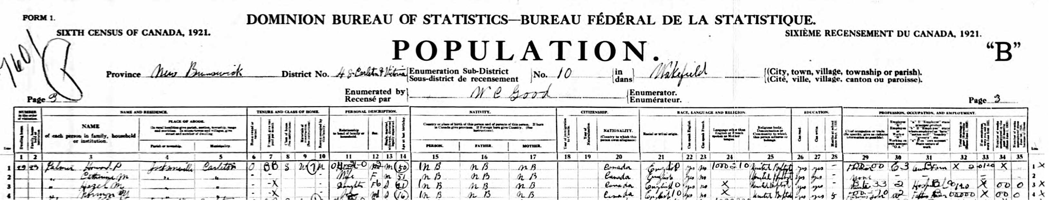
1921 Canada Census – New Brunswick
Parish (Centre) of Wakefield, County of Carleton
Palmer, Howard P., Jacksonville, Carleton, Head, M, M, 50, NB, Canada, United Baptist, own farm
“ Catherine M., “ “ Wife, F, M, 51, NB, Canada, United Baptist
“ Hazel M., “ “ Daughter, F, 21, NB, Canada, United Baptist, nurse in hospital
“ Norman Y., “ “ Son, M, 16, NB, Canada, United Baptist, farmer’s son
Columns on Schedule 1 Population featured Numbered in Order of Visitation: Dwelling House, Family or household, Personal description: Name of each person in family or household on March 31, 1901, Sex, Colour, Relationship to head of family or household, Single, married, widowed or divorced, month and date of birth, year of birth, Age at last birthday, Citizenship, nationality and religion: Country of place of birth (if in Canada specify province or territory and add “r” or “u” to signify rural or urban. Year of immigration to Canada, Year of naturalization, Racial or tribal origin, Nationality, Religion. Principal profession or trade: Means of living of each person (if person has retired from profession or trade, add “r” for retired), Living on own means. Employer. Employee. Working on own account. Wage earner: Months employed at trade in factory or home, months employed in other occupation than trade in factory or home, Earnings from occupation or trade dollars, Extra earnings. Education and language of each person five and over: Months at school in year, Can read, Can write, Can speak English, Can speak French, Mother tongue (if spoken). Infirmities: Deaf and Dumb, Blind, Unsound mind (if infirmity dates from childhood, add “from childhood”.

Slide 41
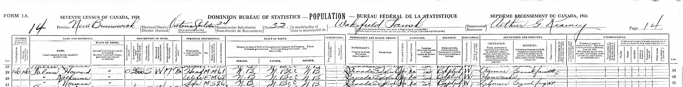
1931 Canada Census – New Brunswick
Parish (Centre) of Wakefield, County of Carleton
Palmer, Howard, Wakefield, Head, M, M, 61, N.B., Canada, Baptist, farmer, general farm
“ , Katherine, “, Wife, F, M, 62, N.B., Canada, Baptist, homemaker
“ , Norman, “, Son, M, S, 26, N.B., Canada, Baptist, Labourer
Columns on Schedule 1 Population featured Numbered in Order of Visitation: Dwelling House, Family or household, Personal description: Name of each person in family or household on March 31, 1901, Sex, Colour, Relationship to head of family or household, Single, married, widowed or divorced, month and date of birth, year of birth, Age at last birthday, Citizenship, nationality and religion: Country of place of birth (if in Canada specify province or territory and add “r” or “u” to signify rural or urban. Year of immigration to Canada, Year of naturalization, Racial or tribal origin, Nationality, Religion. Principal profession or trade: Means of living of each person (if person has retired from profession or trade, add “r” for retired), Living on own means. Employer. Employee. Working on own account. Wage earner: Months employed at trade in factory or home, months employed in other occupation than trade in factory or home, Earnings from occupation or trade dollars, Extra earnings. Education and language of each person five and over: Months at school in year, Can read, Can write, Can speak English, Can speak French, Mother tongue (if spoken). Infirmities: Deaf and Dumb, Blind, Unsound mind (if infirmity dates from childhood, add “from childhood”.

Slide 42
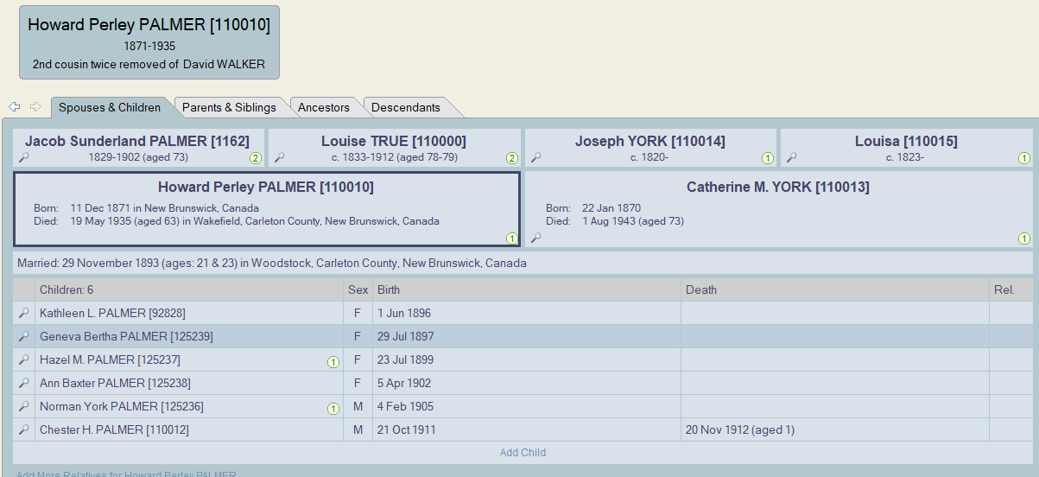
Allow census records guide you to vital records
Referring to the family of Howard Perley Palmer it’s readily obvious that much information is in need of research

Slide 43
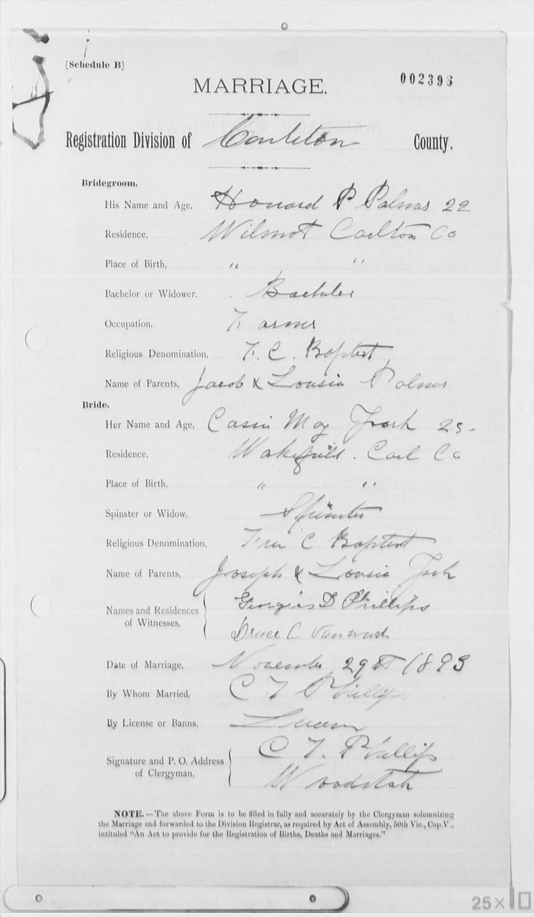
Focusing on the Marriage of Howard Palmer & Catherine/Cassie York, their marriage registration can be found on the New Brunswick Vital Statistics web site

Slide 44
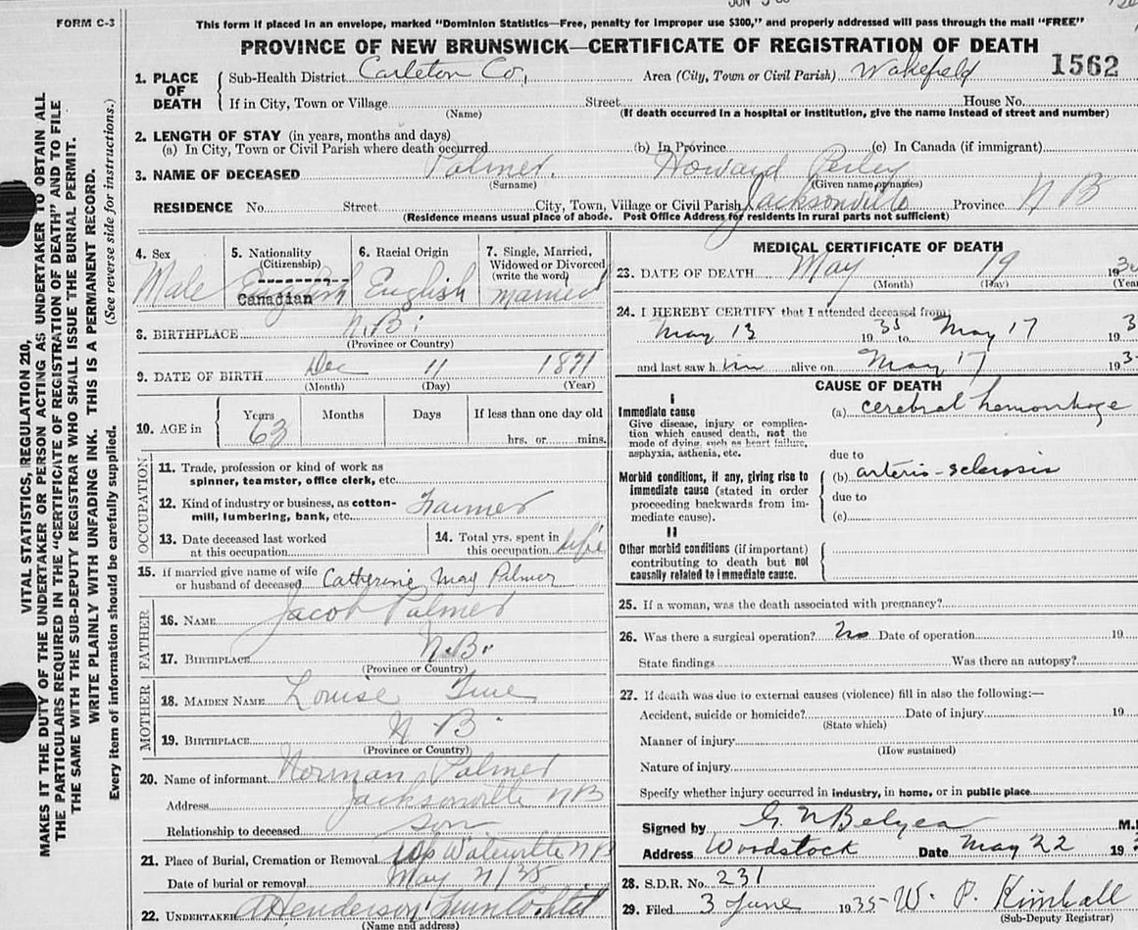
Death Records Were Found for Howard on the New Brunswick Vital Statistics web site

Slide 45
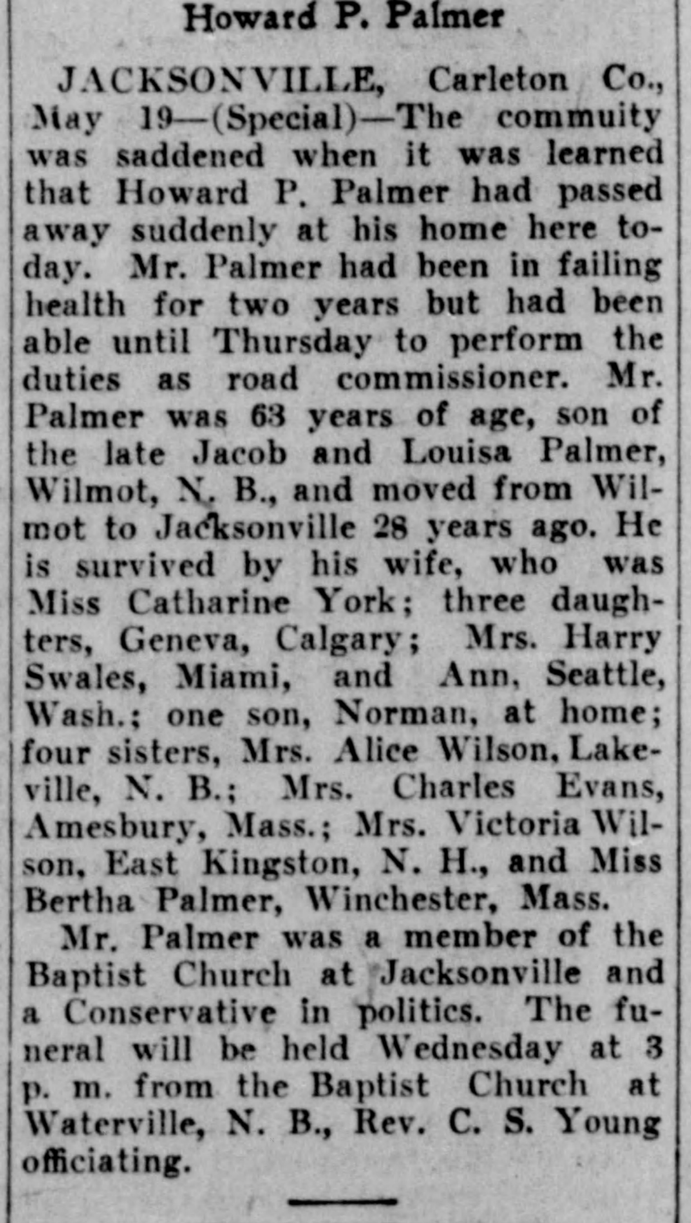
Howard’s Obituary was found on Newspapers.com
We also learn where his children were living at the time of his death

Slide 46
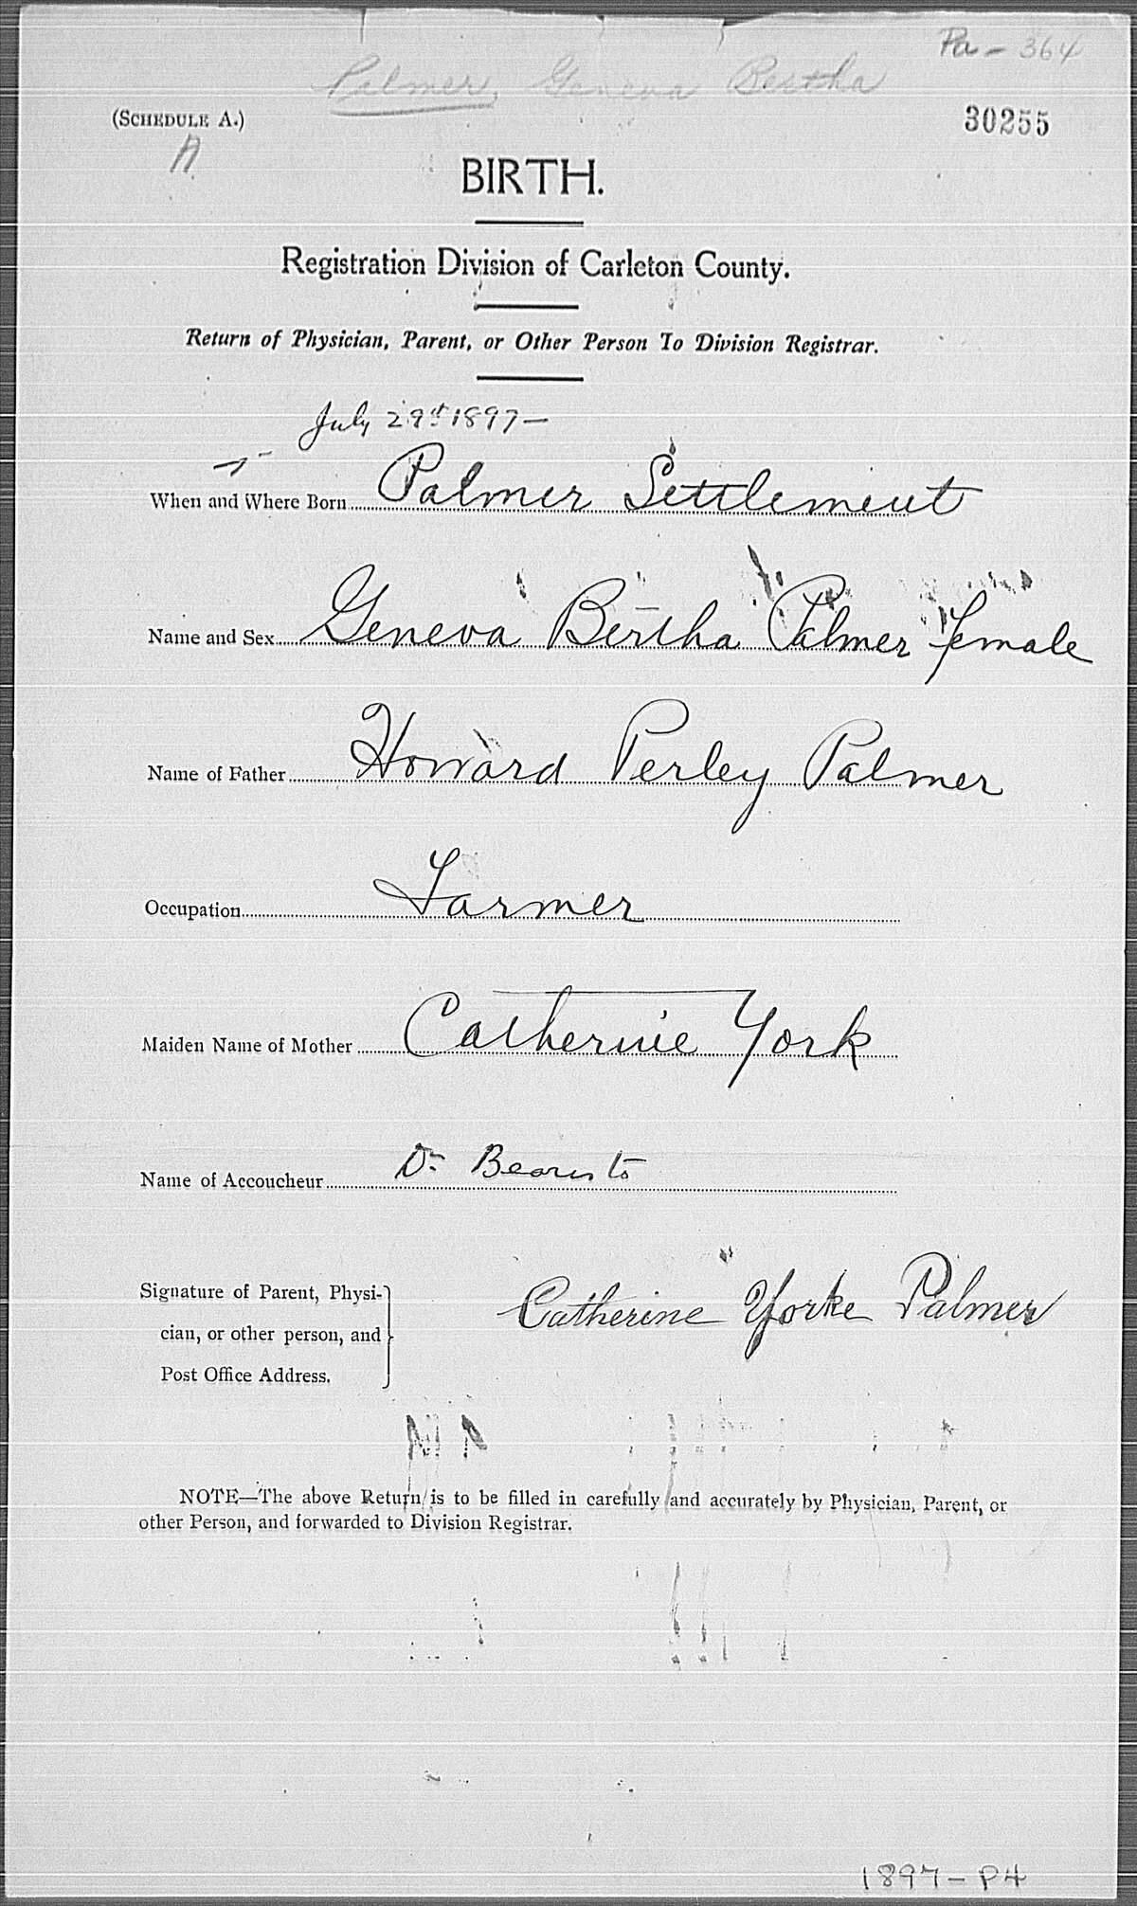
Focusing on the children of Howard Palmer & Catherine/Cassie York, the birth registration for Geneva Bertha Palmer can be found on the New Brunswick Vital Statistics web site

Slide 47
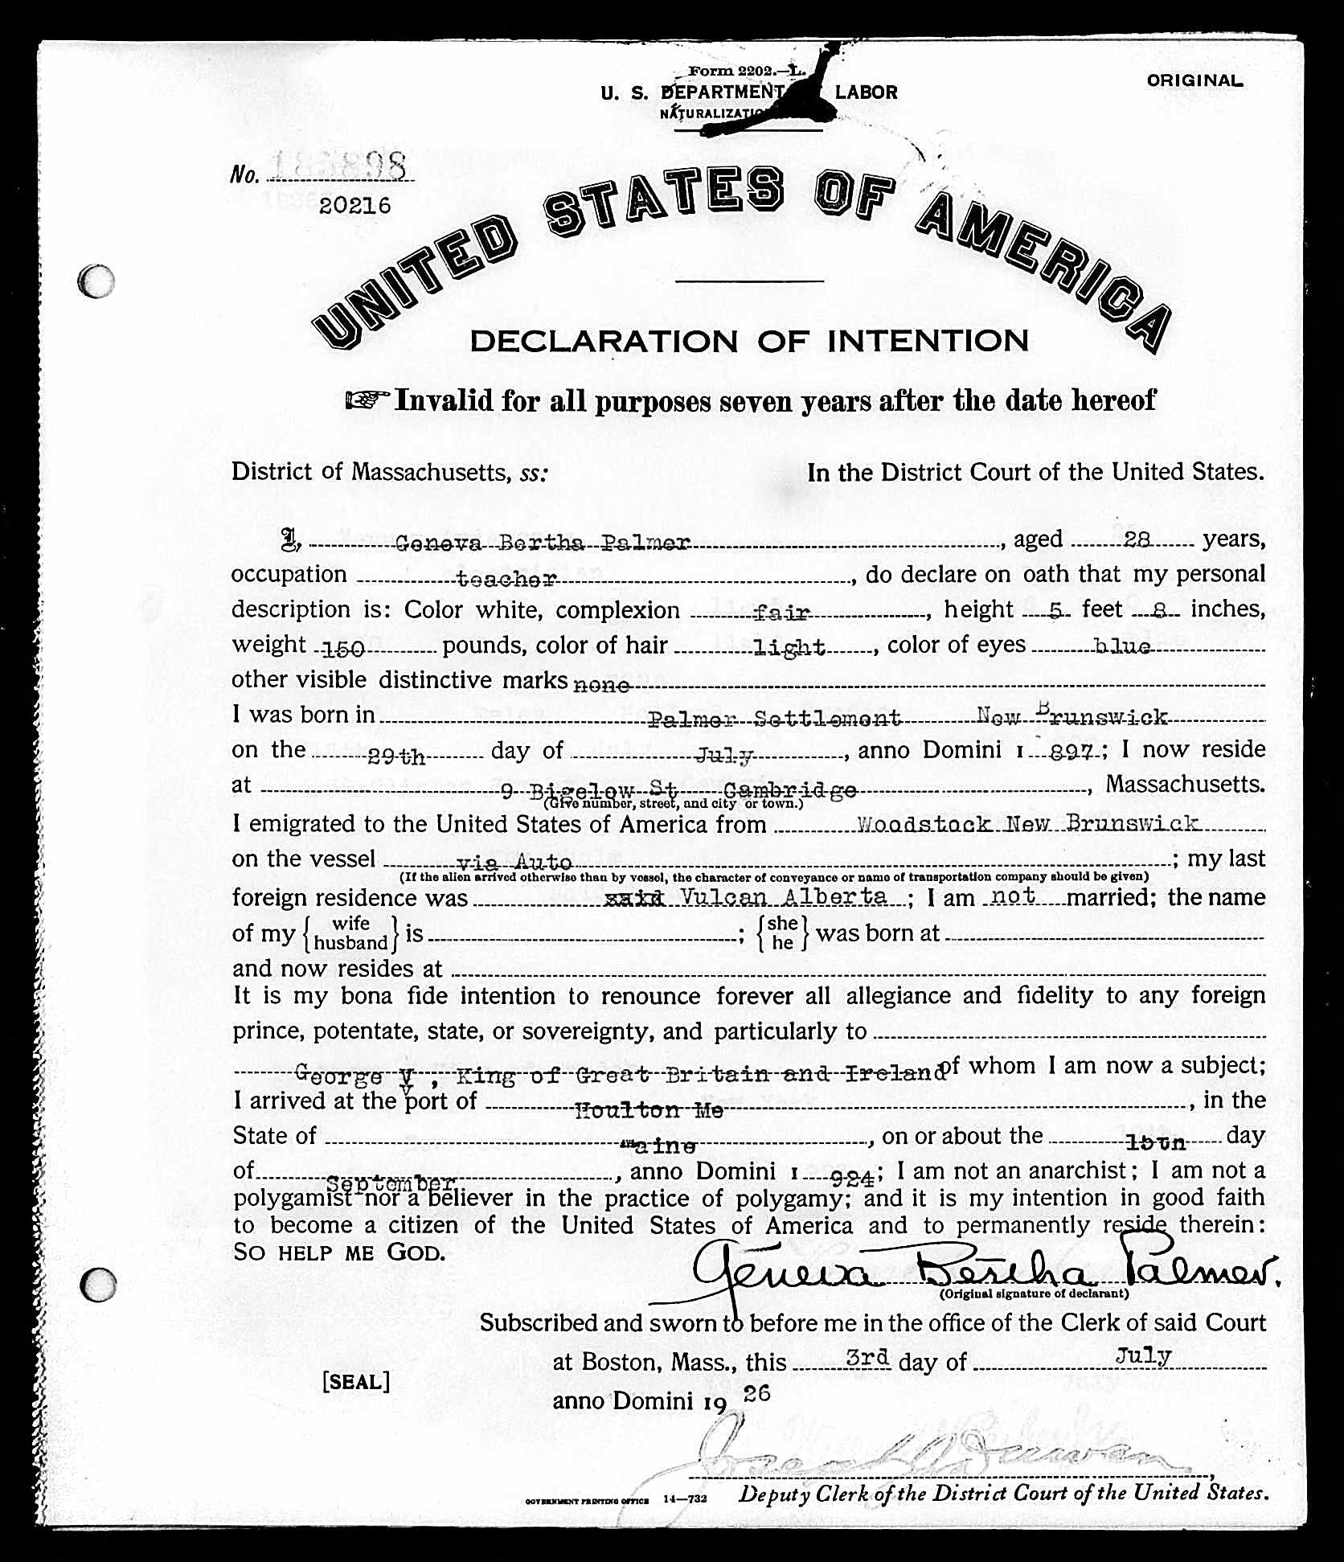
Ancestry.ca - When Geneva was 28 years old she travelled to the USA, crossing at Houlton, Maine. She went on to Boston where she applied for naturalization 3, July 1926.

Slide 48
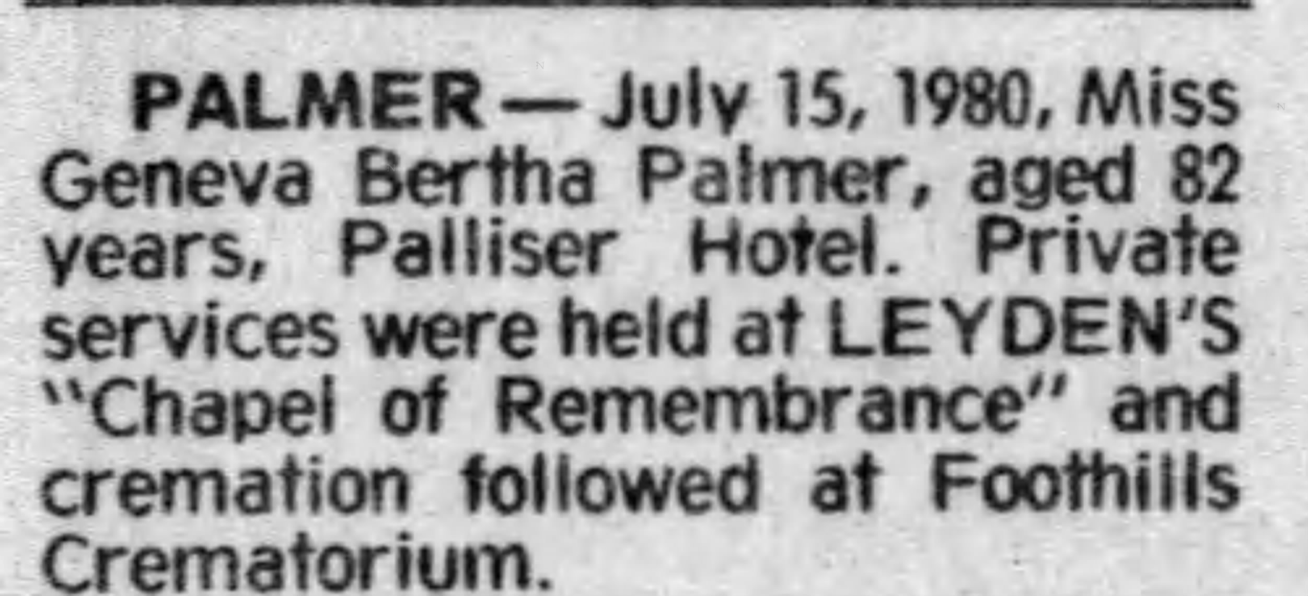
There is an obituary for Geneva Bertha Palmer on Newspapers.com. Calgary Herald. She died unmarried 15 July 1980, aged 82.
From Findagrave.com we learn she is buried in Queen’s Park Cemetery and Mausoleum in Calgary, Alberta.

Slide 49
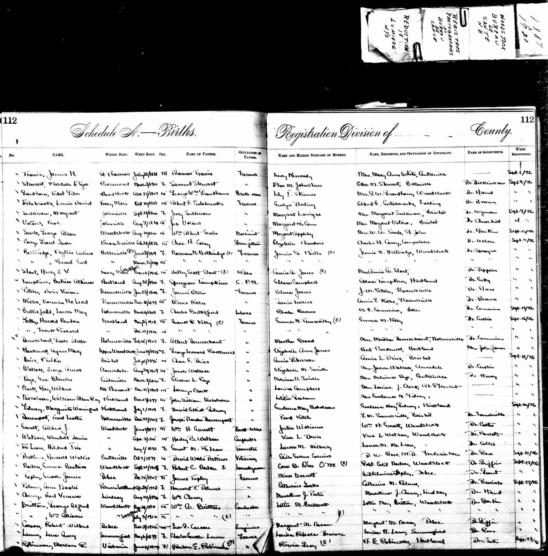

Ancestry.ca – The Drouin Collection is an excellent source of Vital Records in Québec and New Brunswick. This page recorded the birth record for Ann Baxter Palmer, 5 April 1902 in Palmer Settlement.

Slide 50
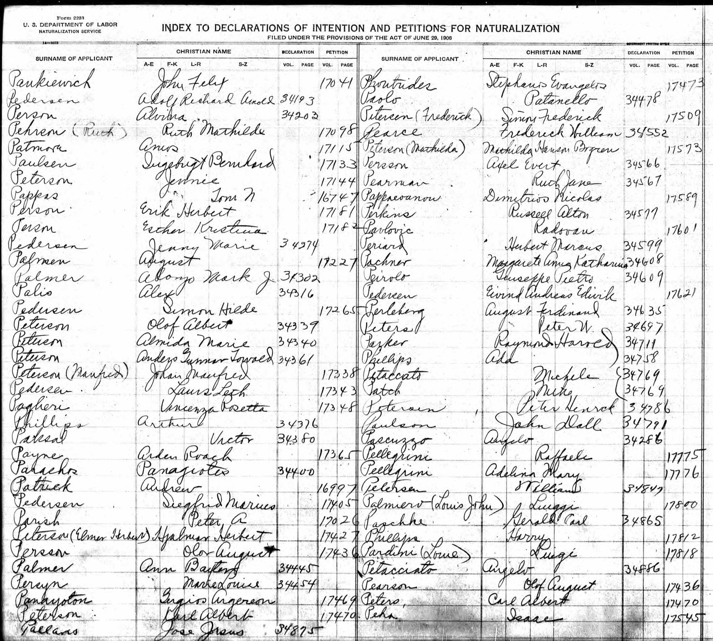

The National Archives in Washington has Indices to Naturalization Records. One such record has an entry for Ann Baxter Palmer, Declaration of Intention for Naturalization, Vol. 344, Page 45.

Slide 51
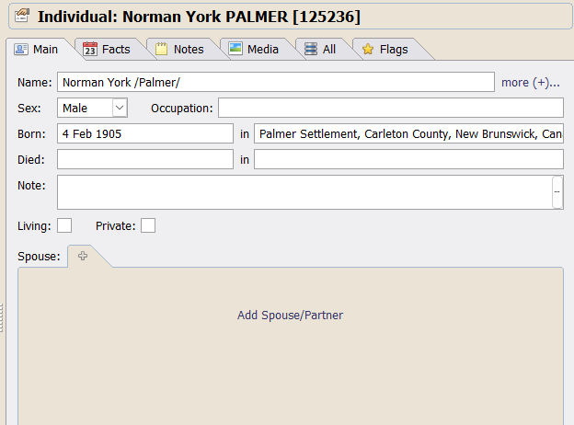
The last member of the family of Howard Perley Palmer and Catherine York is Norman Y. Palmer. Except for finding his birth registration some time ago the only other records I found was his census enumeration in 1911, 1921 and 1931.

Slide 52
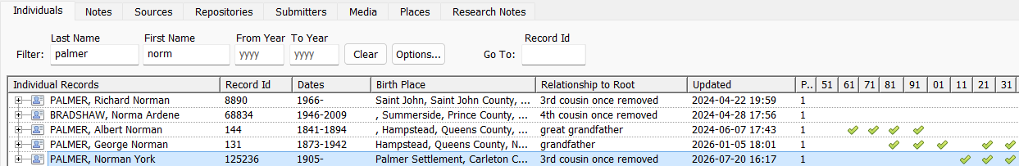

Slide 53
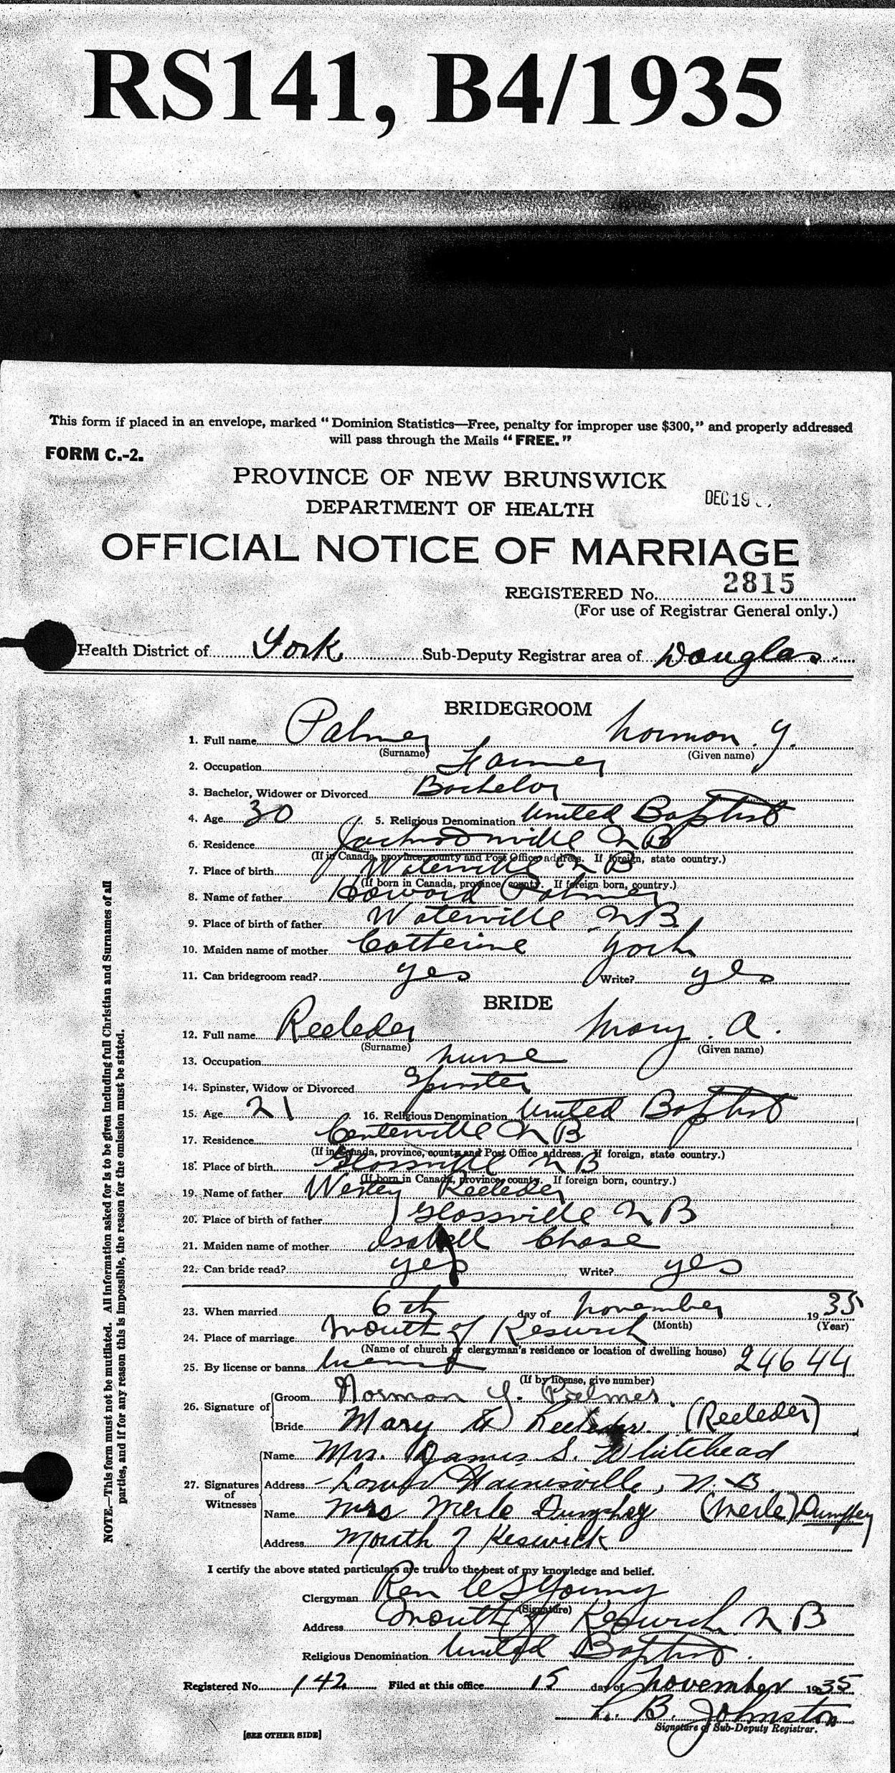
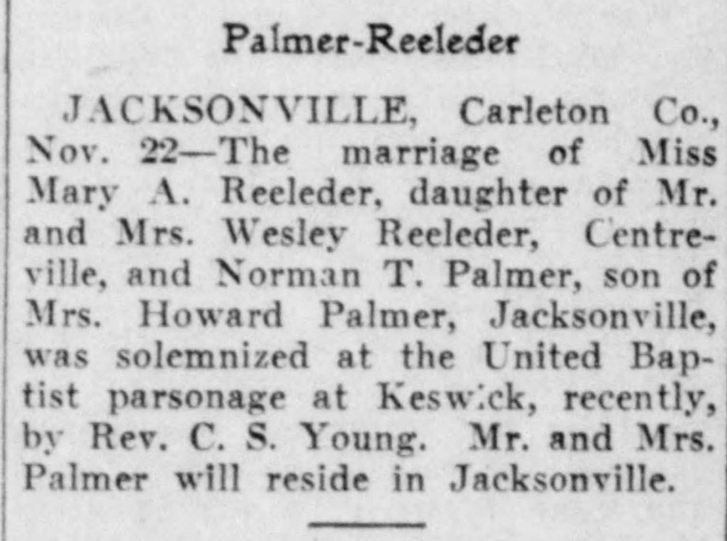
The census enumerations will be used as a stepping stone for other records. The next event in Norman’s life was his first marriage, 6 November 1935, to Mary A. Reeleder. This was found on the web site of the Province of New Brunswick, Vital Statistics. This document also provides the names of the bride’s parents.
A wedding announcement was found on the Telegraph-Journal newspaper of Saint John, New Brunswick, published 23 November 1935. Notice the typo in Norman’s name. The ‘T’ ought to be ‘Y’. Those keys are adjacent to each other on a keyboard.

Slide 54
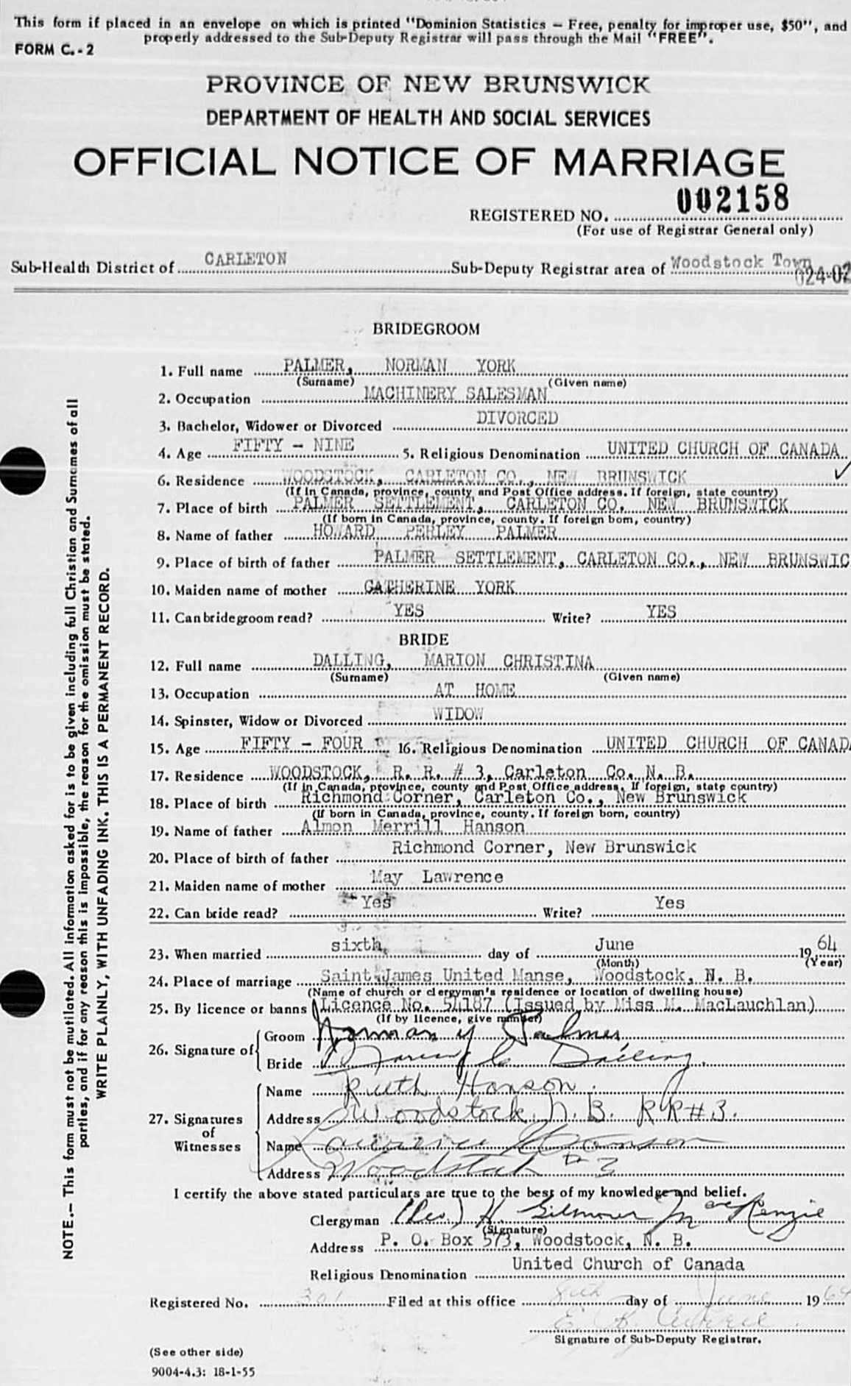
Having divorced from Mary Reeleder, Norman married a second time. From Vital Statistics at the Provincial Archives of New Brunswick, one can view the Official Notice of Marriage to Marion Christina Dalling, now widowed, 6 June 1964. Norman was 59, Marion was 54. This also provides information on her birth and parents.

Slide 55
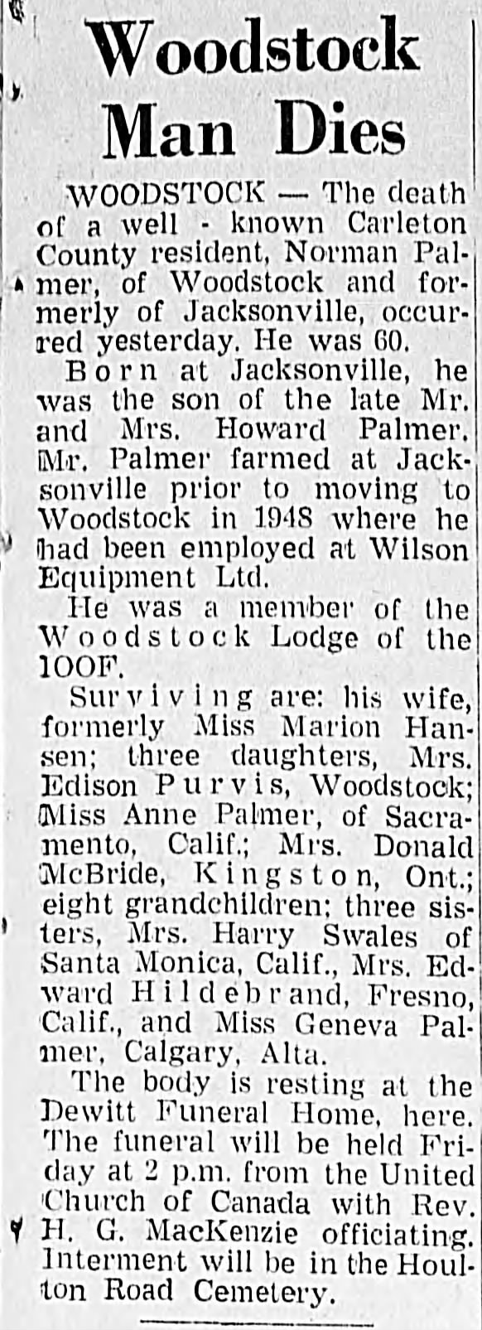
The next event in Norman Palmer’s life would be his death. On Newspapers.com one can view his obituary. This publication also provides where his various family members were living at the time of his death.

Slide 56
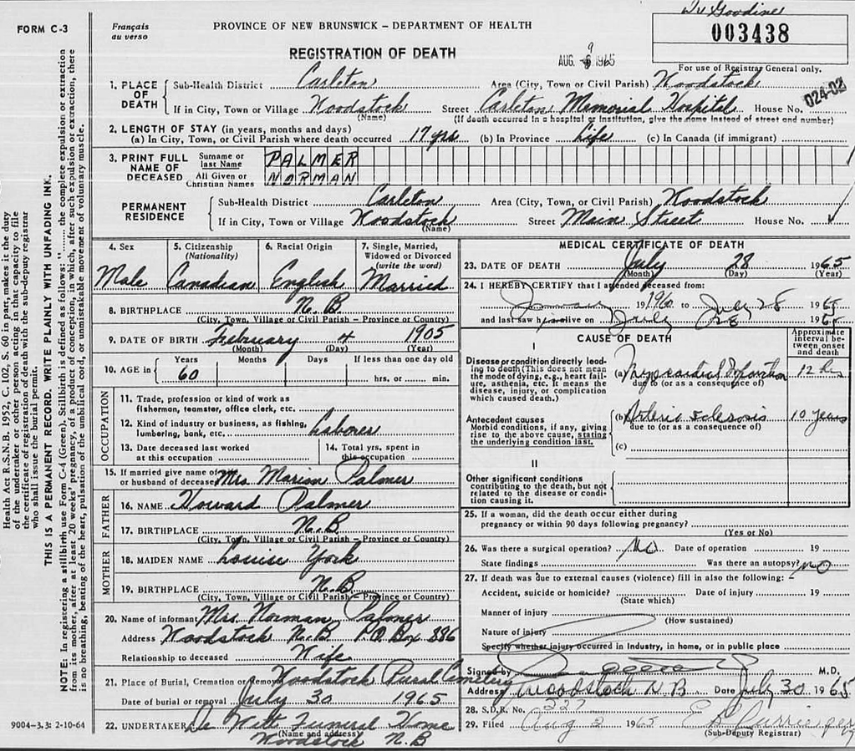
Norman’s Registration of Death can be found on the Vital Statistics page of the Provincial Archives of New Brunswick

Slide 57
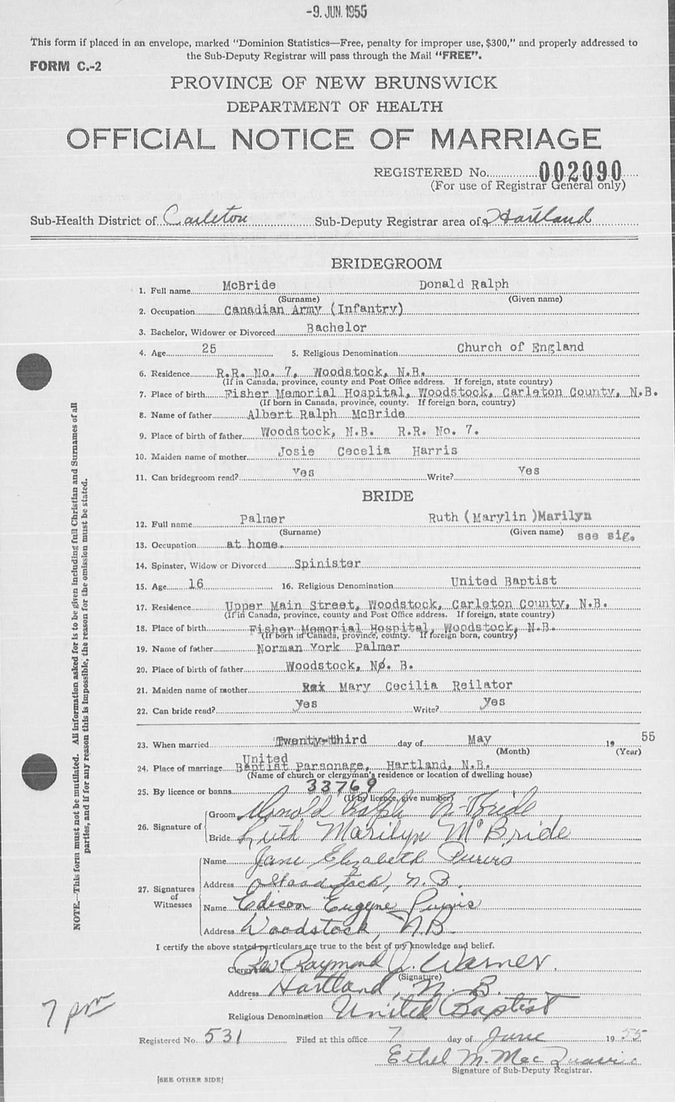
Moving forward, we find the burial record of Norman Y. Palmer on Findagrave.com. It also provides BDB information for his wife Marie Christina Hanson. Plus, we see that they had a daughter, Ruth Marilyn Palmer, who married twice, to Donald Ralph McBride in 1955 and Lloyd Philip Culbert in 1993.
Right: Official Notice of Marriage of Ruth Marilyn Palmer and her first husband Donald Ralph McBride.

Slide 58
Summary:
We have come a long way from researching Canada Census records of Jacob Sunderland Palmer, Loyalist descendant, grandson of Loyalist Marcus Palmer from Dutchess County, New York.
We moved on to Jacob’s son Howard Perley Palmer. The acquired census records for his first 5 children were used as a starting point to locate BMDB records. Twenty-four new vital records were found from various sites.
We then looked for people who were from away, not at a home of their own at the time of a given census, using a Custom Query in Family Historian. Thirty-nine people were found at a hospital (patient or nurse) or lodgers/boarders at various locations, mostly in the household of an unrelated person.

Slide 59
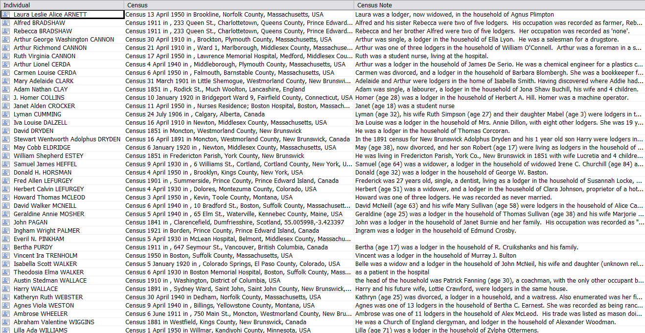
Fifty-seven people from away found at various location during various censuses

Slide 60
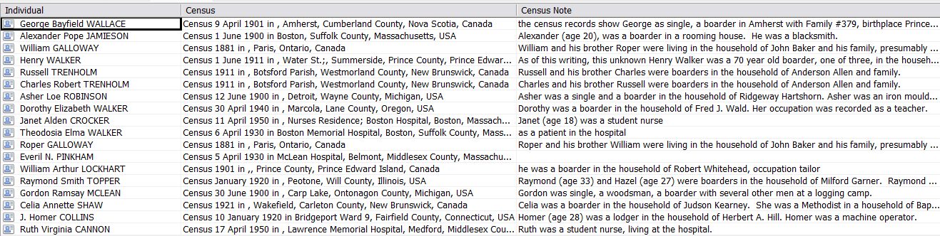
Fifty-seven people from away found at various location during various censuses

Slide 61
Suggested Web Sites
Ancestry.ca – www.ancestry.ca
Automated Genealogy – www.automatedgenealogy.com
FamilySearch – https://www.familysearch.org/eng/Canada/
Library and Archives Canada –Welcome to the Library and Archives Canada website
Bibliothèque et Archives Nationale du Québec – BAnQ Digital | Bibliothèque et Archives nationales du Québec
Prince Edward Island: Public Archives and Records Office
New Brunswick: Vital Statistics
Nova Scotia: Nova Scotia Archives - Nova Scotia Births, Marriages, and Deaths

Slide 62
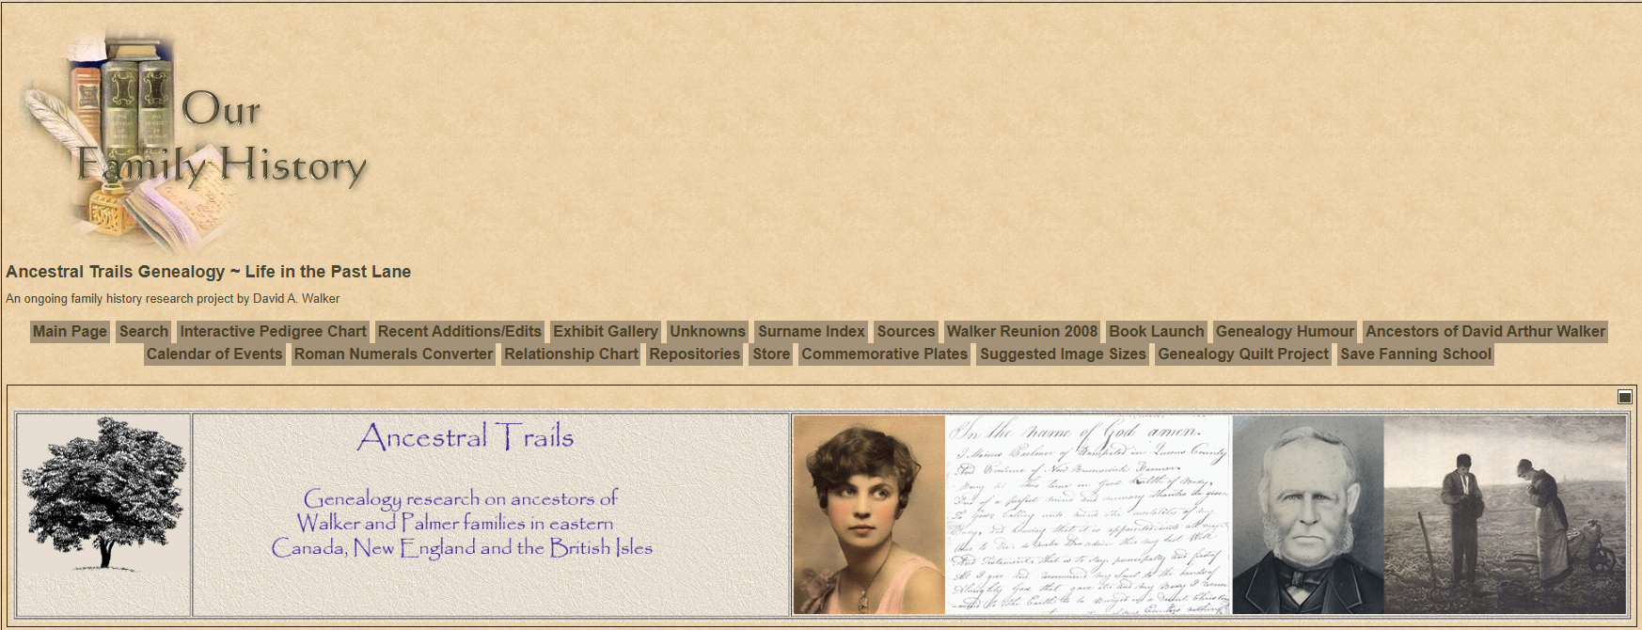
Ancestral Trails Genealogy ~ Life in the Past Lane - Main Page
https://www.ancestraltrails.ca

